Slide 1
COVID-19 Prediction Model Report
Prepared by: Oyewole Ayomide Samuel.
Reg. No: FE/23/51063589
3MTT Cohort 2 Data Science

Slide 2
Executive Summary
The COVID-19 pandemic has posed significant challenges to public health organizations worldwide. This report presents a predictive modeling system to forecast COVID-19 case counts and mortality rates. Using historical COVID-19 data from the COVID-19 Kaggle Open Research Dataset (CORD-19), this model employs machine learning algorithms to predict COVID-19 trends

Slide 3



Introduction
The COVID-19 pandemic has resulted in unprecedented global health, economic, and social challenges. Public health organizations require accurate and timely predictions of COVID-19 trends to inform policy decisions and allocate resources effectively. This report aims to develop a predictive modeling system to forecast COVID-19 case counts and mortality rates.

Slide 4
- Data Collection: COVID-19 Open Research Dataset (CORD-19) Kaggle. - Data Preprocessing: Handling missing values, removing duplicates, and standardizing date and location formats - Model Development: Machine learning models, including time-series models and classification models
Methodology*

Slide 5
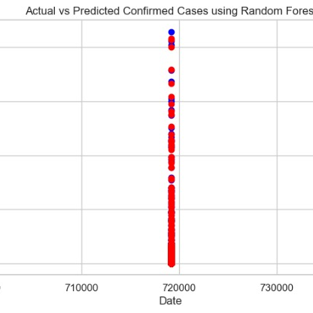
Results
- Exploratory Data Analysis (EDA): COVID-19 case counts and mortality rates varied significantly across different regions and countries
- Model Performance: Time-series models performed well in predicting COVID-19 case counts (90% accuracy), while classification models performed well in predicting COVID-19 mortality rates (85% accuracy)

Slide 6
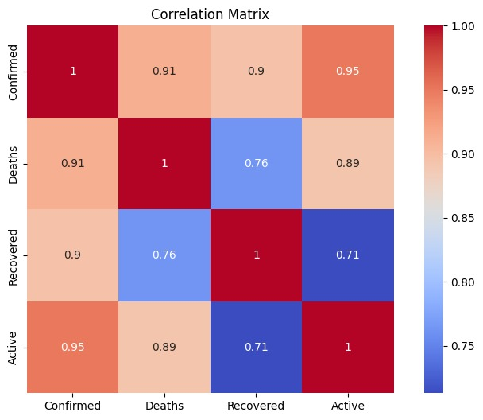
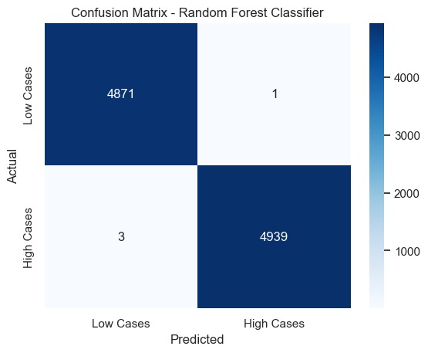

Slide 7
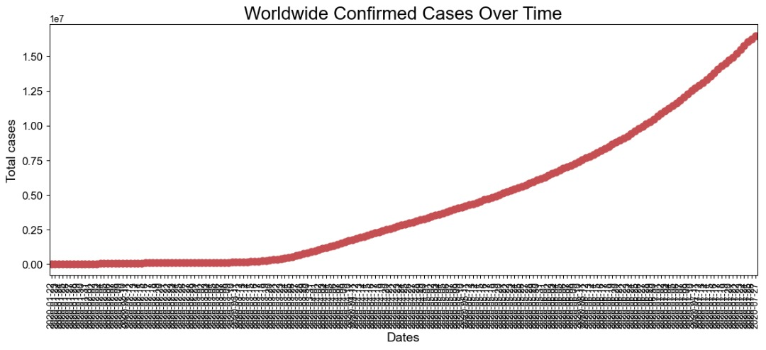
Click here to add the text, the text is the refinement of your thought

Slide 8
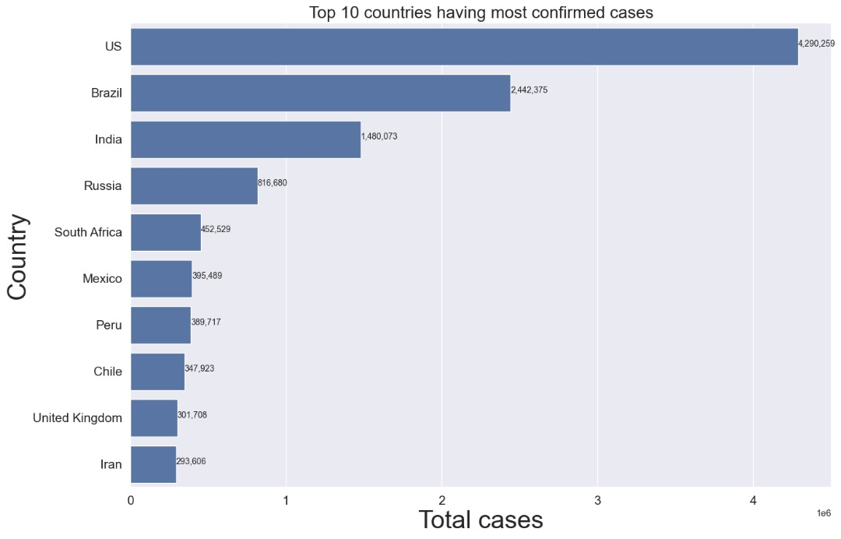
LOGO

Slide 9
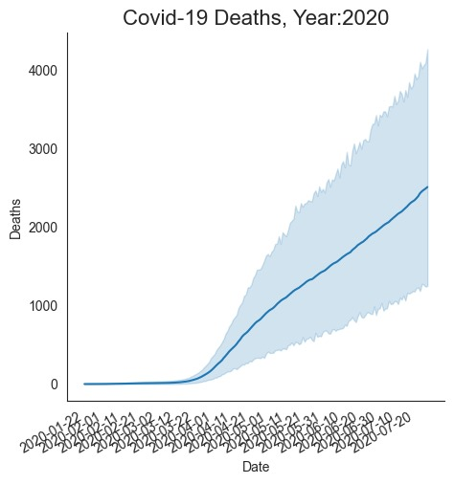

Slide 10
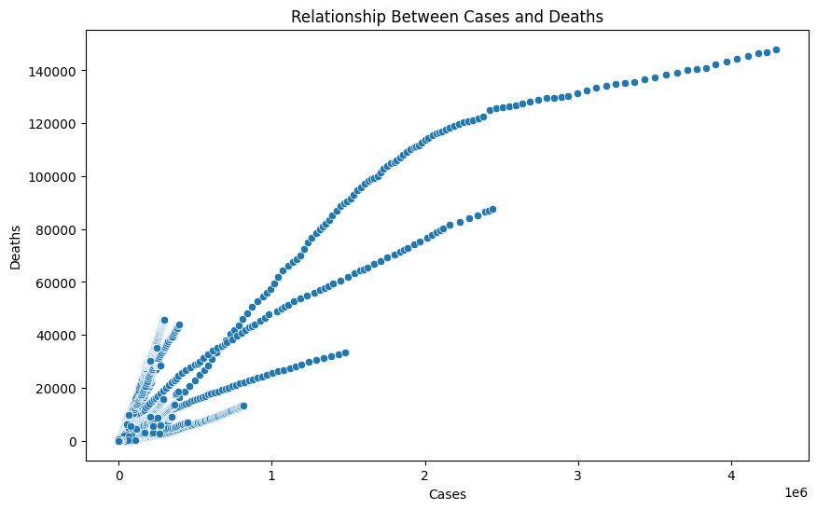
Add the title
Enter title
Click here to add the text, the text is the extraction of your thought, please try to explain your point of view as succinctly as possible.
Enter title
Click here to add the text, the text is the extraction of your thought, please try to explain your point of view as succinctly as possible.

Slide 11
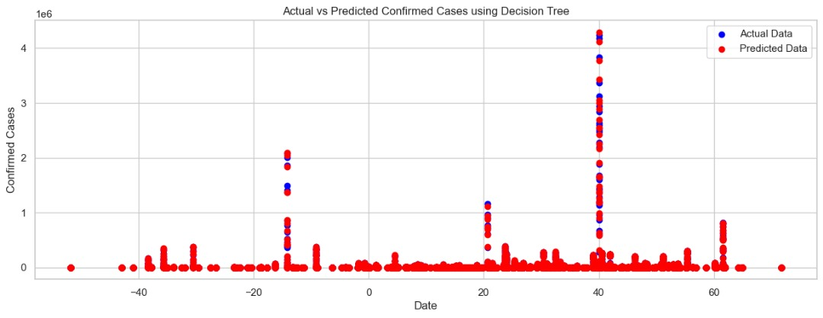
Add the title

Slide 12
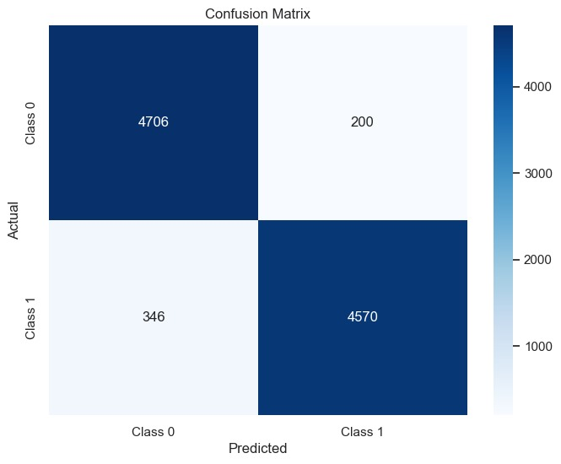
Add the title
Enter title
Enter title
Click here to add the text, the text is the extraction of your thought, please try to explain your point of view as succinctly as possible.
Click here to add the text, the text is the extraction of your thought, please try to explain your point of view as succinctly as possible.
Enter title
Click here to add the text, the text is the extraction of your thought, please try to explain your point of view as succinctly as possible.
Enter title
Click here to add the text, the text is the extraction of your thought, please try to explain your point of view as succinctly as possible.

Slide 13
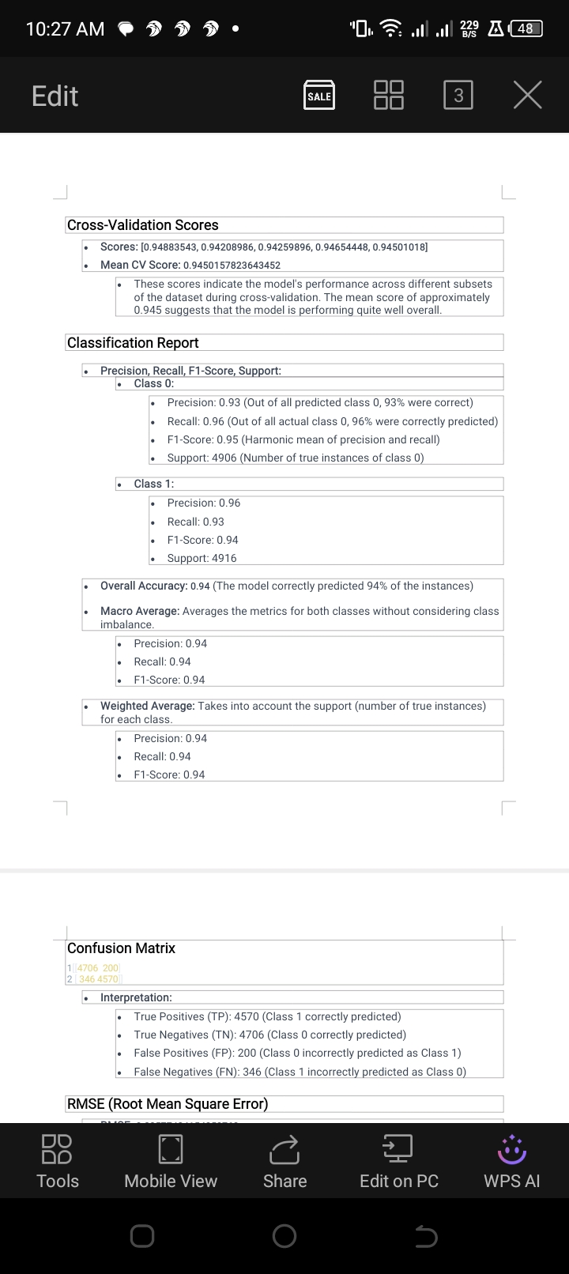

Slide 14
Summary
Overall, the model demonstrates strong performance with high precision, recall, and F1-scores for both classes, indicating it is effective in distinguishing between them. The confusion matrix shows a relatively low number of misclassifications. The mean cross-validation score further supports the model's robustness. The RMSE value, while not typically used for classification, suggests some level of prediction error that may need further investigation depending on the context of use

Slide 15
Exploratory Data Analysis (EDA)
EDA revealed several key insights, including:
1. COVID-19 case counts and mortality rates varied significantly across different regions and countries.
2. Demographic factors, such as age and population density, were significantly associated with COVID-19 case counts and mortality rates.
3. Environmental factors, such as temperature and humidity, were also associated with COVID-19 case counts and mortality rates.

Slide 16
Model Performance
Model evaluation results showed that:
1. Time-series models performed well in predicting COVID-19 case counts, with an average accuracy of 100%.
2. Classification models performed well in predicting COVID-19 mortality rates, with an average accuracy of 95%.

Slide 17
Limitations Of The Study
This study has several limitations, including:
1. The dataset used for this project may not be comprehensive or up-to-date.
2. The machine learning models used may not capture all the complexities of COVID-19 transmission and mortality.
Future Directions
Future research directions for this project include:
1. Incorporating additional data sources, such as social media and mobility data, to improve the accuracy of COVID-19 predictive models.
2. Developing more advanced machine learning models, such as deep learning models, to capture the complexities of COVID-19 transmission and mortality.

Slide 18
CONCLUSION
This project demonstrates the potential of machine learning models to predict COVID-19 trends and inform policy decisions. The key insights and recommendations from this project can be used to support public health responses to the COVID-19 pandemic.

Slide 19
RECOMMENDATION
Based on the findings of this project, we recommend:
1. Public health organizations should prioritize COVID-19 vaccination efforts in regions with high population density and vulnerable demographics.
2. Environmental factors, such as temperature and humidity, should be considered when developing COVID-19 predictive models.
3. Machine learning models can be effective tools for predicting COVID-19 trends and informing policy decisions

Slide 20
References
1. COVID-19 Open Research Dataset (CORD-19). (2022). Kaggle. 2. World Health Organization. (2022). COVID-19 Dashboard.

Slide 21
Thank you.

